Slide 1


DEPARTMENT OF ELECTRICAL AND ELECTRONICS ENGINEERING
BATCH NO – 17
18EEP20L – MINOR PROJECT - 1
( FINAL REVIEW)
YEAR : SECOND YEAR
AUTOMATIC RAIN SENSING CAR WIPER SYSTEM
Date : 17.11.2021
Team Members
Abinaya.P (20BEE4001)
Guided By
Dharunish.A.P (20BEE4015)
Mr P L Somasundaram
(A/P) EEE Department
Santhosh.K (20BEE4079)

Slide 2


Slide 3
LIST OF CONTENTS
INTRODUCTION
ABSTRACT
OBJECTIVE
BLOCK DIAGRAM AND ITS DESCRIPTION
LIST OF THE COMPONENTS
PROTOTYPE WORKING AND SANAPSHOT
COMPONENTS PRICE LIST , MERITS AND APPLICATIONS
FUTURE SCOPE
CONCLUSION

Slide 4
INTRODUCTION
We have pleasure in introduction our new project “AUTOMATIC RAIN SENSING CAR WIPER SYSTEM”, which is fully equipped by sensors circuit and wiper motor.
It is a genuine project which is fully equipped and designed for Automobile vehicles. This forms an integral part of best quality.
This is an era of automation where it is broadly defined as replacement of manual effort mechanical power in all degrees of automation.
In semi automation a combination of manual effort and mechanical power is required whereas in full automation human participation is very negligible.

Slide 5
ABSTRACT
Today’s car wipers are manual systems that work on the principle of manual switching. So, here an automatic wiper system that automatically switches ON by detecting rain and stops when rain stops.
This project brings forward this system to automate the wiper system having no need for manual intervention.
For this purpose we use rain sensor along with microcontroller and driver IC drive the wiper motor.
This system uses rain sensor to detect rain, this signal is then processed by microcontroller to take the desired action.
The rain sensor works on the principle of using water for completing its circuit, so when rain falls on it the circuit gets completed and sends out a signal to the microcontroller.
The microcontroller now processes this data and drives the motor IC to perform required action. The driver motor IC now drives a servomotor to stimulate as a car wiper.

Slide 6
OBJECTIVE
In the present automobiles the number of facilities is much higher.
The driver has to concentrate on road while driving and with increased traffic, things get frustrating.
The features in the car like GPRS to trace the route, music system, air condition system etc may drive away the attention of the driver.
Thus an effort has been made to reduce the effort put by driver in controlling the speed of the wiper and put more concentration on his driving and it avoids the accidents.
Since this system is put into use in many higher end cars and has been successfully working
An effort was made to reduce the cost of the system so that this system can be implemented in common economic cars where a common man can also enjoy the benefits.

Slide 7
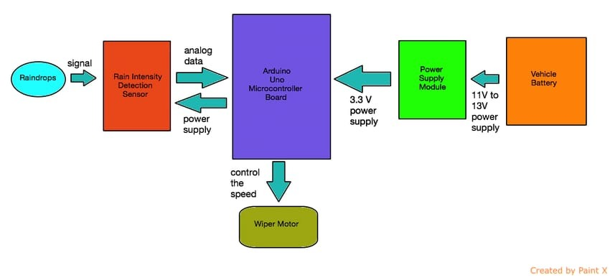
BLOCK DIAGRAM

Slide 8
BLOCK DIAGRAM DESCRIPTION
The power supply is given to the Arduino UNO through power supply module.
Then the wiper motor is automatically on during the time of rainfall.
This sensor is fixed in the vehicle glass.
It senses the rainfall and giving control signal to the control unit.
The control unit activate the wiper automatically.
The rain sensor works on the principle of using water for completing its circuit.
So when rain falls on it it’s circuit gets completed.

Slide 9
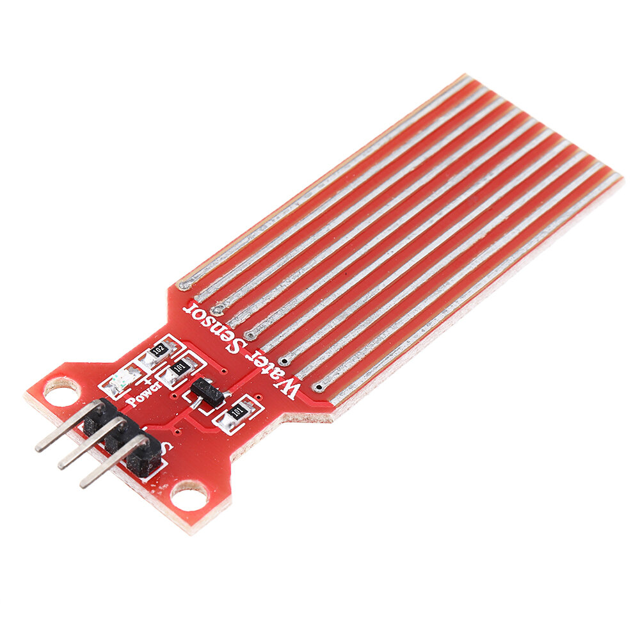
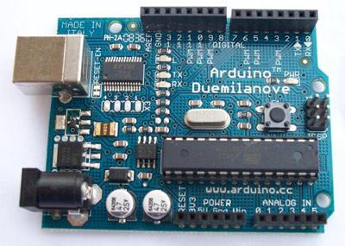
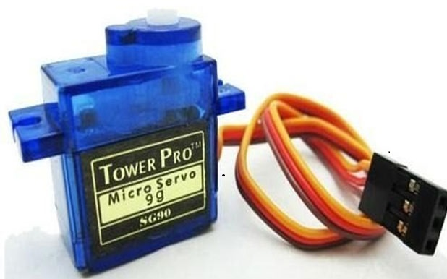
LIST OF COMPONENTS
Arduino UNO
Servo Motor
Rain Sensing Module

Slide 10
PROTOTYPE WORKING
The rain sensor will be placed on the vehicle front glass.
Whenever the droplets of the rain fall on the rain sensor , it will sense the rainfall and transmits the necessary information to Arduino UNO.
The Arduino module will estimate the intensity of rainfall by manipulating the signal given by the rain sensor module.
After detecting the rain by rain sensor module , the servo motor is switched on by microcontroller (Arduino UNO).
The servo motor will takes the signal in the form of pulse with modulation , which is the representation of the intensity of rainfall.
The servo motor will then rotate the wiper in accordance with the signal given by the Arduino module.
The wiper will rotate in accordance with the intensity of the rainfall.

Slide 11
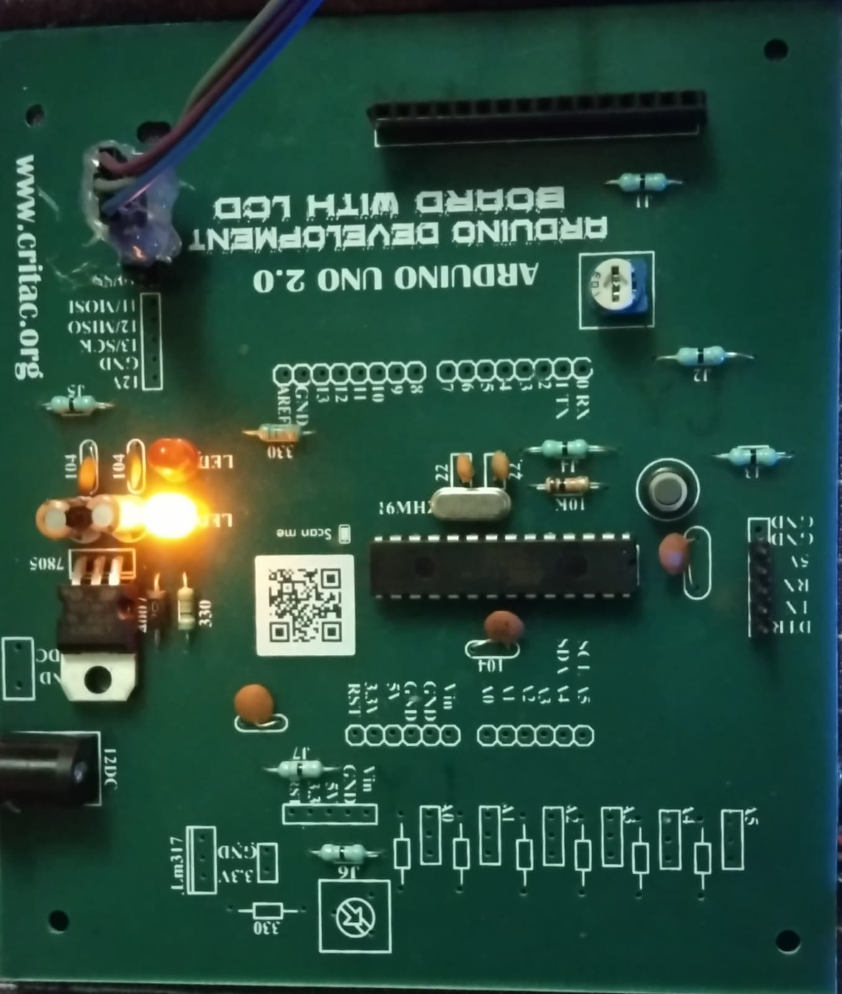
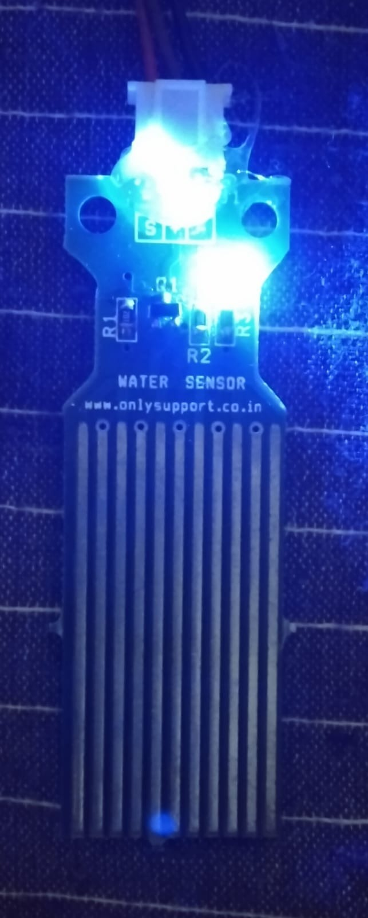
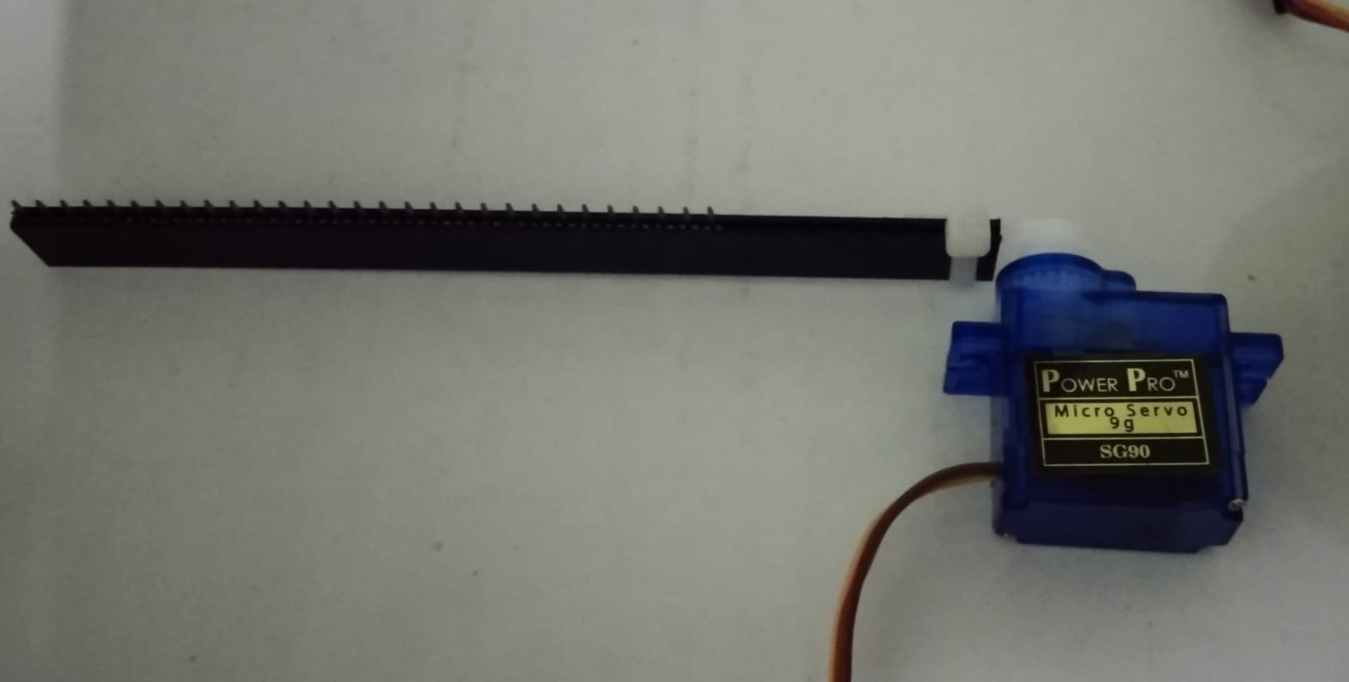
PROTOTYPE SNAPSHOT

Slide 12
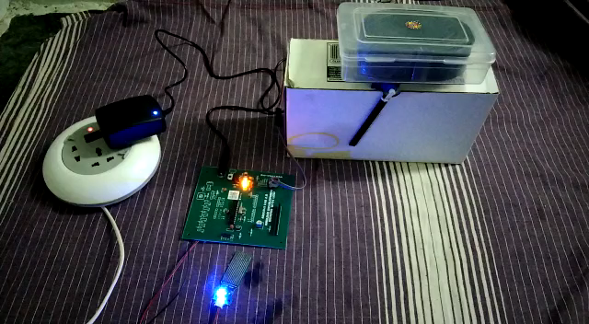
PROJECT DEMONSTRATION

Slide 13

COMPONENTS WITH ITS PRICE
Arduino UNO - 885
Servo motor - 175
Rain sensing module - 165
Input supply adapter - 275
Total estimation of our project is thousand and five hundred ( 1500)

Slide 14
MERITS
Low power consumption
Simple and portable
Easy to implement
Cost effective
It can be easily and quickly installed in automobiles

Slide 15
APPLICATIONS
It is used in four wheeler
It is used in aircraft
It is used in train
It is used in six wheeler

Slide 16
FUTURE SCOPE
Using more appropriate rain sensor , we can make more precise automatic wiper system.
By adding microcontroller based system , we can implement some security features for automobiles.
Using microcontroller we can make this project more effective as it will enable the wiper rotate through 180 angle rather than 360.
We can use a capacitance sensor which will enable it work along
line of sight.
The speed controlling mechanism can be added in this project which will make it work
according to the intensity and speed of water coming on the sensor.

Slide 17
CONCLUSION
We will to say there are still numerous kinds of enhancements one can implement on this project to make it ever more convenient.
The project we have made and presented is quit efficient and it is cost effective also.
It has great advantage of over optical sensor covering all the design specification together requirements of common man

Slide 18
REFERENCES
CONTENT SOURCE
https://www.youtube.com/watch?v=U76uMejQal0&t=10s
https://www.youtube.com/watch?v=sJAnn0gkeh8&t=93s
VIDEO SOURCE
https://www.researchgate.net/search/publication?q=Automatic+car+wiper+system

Slide 19


Slide 20


